Slide 1

Issues affecting increased utilisation of Advanced Bio-Fuels in the Marine Sector
Paul Bennett and Steve Rogers – The Dream Team!!

Slide 2
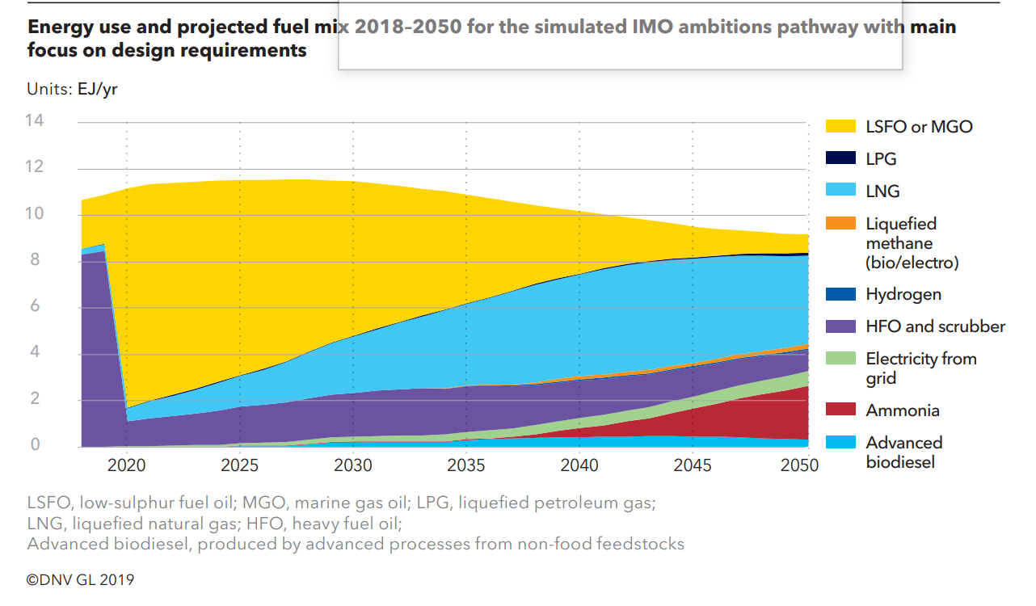
Opportunity
MARPOL Annex VI
* Carbon intensity of international shipping to decline to reduce CO₂ emissions by at least 40% by 2030, pursuing efforts towards 70% by 2050, compared to 2008
* GHG emissions by at least 50% by 2050 compared to 2008

Slide 3
Challenges
Standards
MARPOL Annex VI
Regulation 18
Fuel oil availability and quality
Fuel oil quality
3 Fuel oil for combustion purposes delivered to and used on board ships to which this
Annex applies shall meet the following requirements:
3.1 except as provided in paragraph 3.2 of this regulation:
.1.1 the fuel oil shall be blends of hydrocarbons derived from petroleum
………………
3.2 fuel oil for combustion purposes derived by methods other than petroleum
refining shall not:
………………………
IEA Bioenergy Task 39 - Stockholm- Sept 2019

Slide 4

Is ISO 8217-2017 a reasonable basis for marine biofuel oil specs?

Slide 5
Total Acid Number - Acidic compounds in biocrudes are very weak acids and should not be a corrosion threat.
ISO method states that there is no recognised correlation between acid number and the corrosive activity – indeed some FO derived from naphthenic crudes do have high AN but do not result in excessive corrosion in an engine
Present spec in 2.5 mg KOH/g; values up to 45 mg KOH/g have been seen in bio material.
What we need is a new test method and a new spec limit for biofuels?
IEA Bioenergy Task 39 - Stockholm- Sept 2019

Slide 6
Density - Most marine fuel oils have to have a density of less than 991 kg/m3 at 15°C although the heaviest grades are allowed to go to 1010 kg/m3.
The main reason for the density spec is to remove any free water from the fuel by settling and draining in a bunker tank and centrifuging.
Biocrude vacuum distillate has a density of ~1070 kg/m3, probably because it contains 10-12% oxygen.
The issue is in the separation equipment on the vessels. Given that the oxygenated FO may have different water solubility as well, then potentially the water limit could also be impacted.
So while the high density may be misleading, it is still important and will affect the fuel preparation on the vessel.
Do we need a new spec together with a methodology for water removal?
IEA Bioenergy Task 39 - Stockholm- Sept 2019

Slide 7
Calculate Carbon Aromaticity Index - An index calculated from a fuel’s density and its viscosity. It correlates with the degree of aromatic carbon for conventional petroleum fuels.
The higher the aromatic carbon content, the worse the combustion quality in a marine diesel engine.
Biofuels have a high density (see above) because of their high oxygen content, not because of their high aromatics content.
This index gives a false indication of biofuels combustion quality. A new index or test is needed to reflect the combustion characteristics of bio fuel for marine diesel use.
IEA Bioenergy Task 39 - Stockholm- Sept 2019

Slide 8
Other possible considerations
Need consideration would be oxidation stability (total sediment aged ISO10307-2).
Compatibility of mineral FO and oxygenated biocrude blends. It is possible that mixing of biocrude FO with mineral FO in a ships bunker tanks could result in an unstable mix that could result in component precipitation (blocking filters etc)
IEA Bioenergy Task 39 - Stockholm- Sept 2019

Slide 9
Possible collaboration with:
Engine Manufacturers
  * Wartsila
  * MAN
  * MAG
Fuel Suppliers/Bunkerers
* Good Fuels
Operators
* DNV
IEA Bioenergy Task 39 - Stockholm- Sept 2019

Slide 10
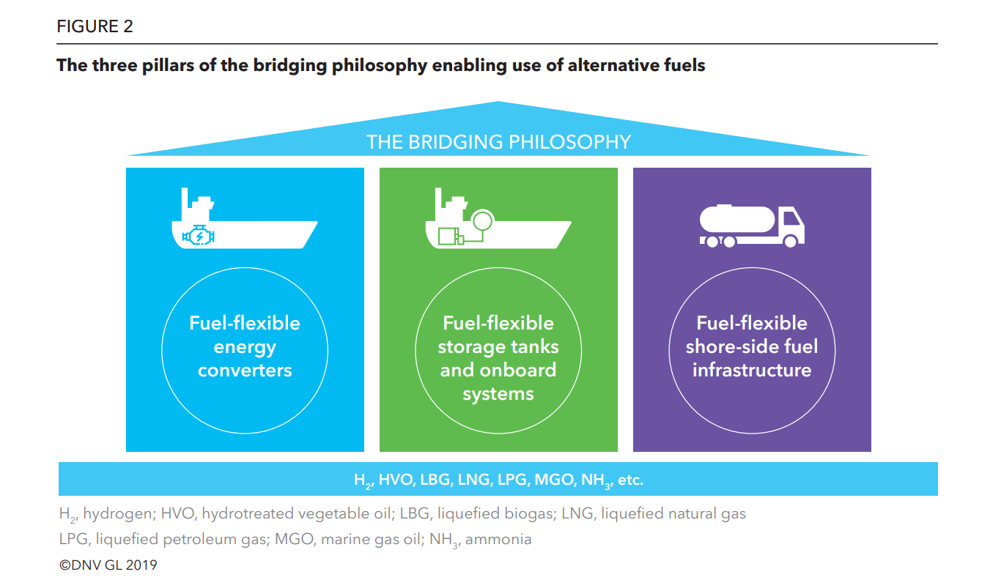
Challenges

Slide 11
Thoughts?
Anything else to consider?

