Slide 1
Identifying certification scheme improvement opportunities
Paul Sinnige
Netherlands Enterprise Agency

Slide 2
Introduction
Review certifications used for oleochemical- and lignocellulosic-based biofuels supply chains to identify certification scheme improvement opportunities
Doubts on certification limit the commercialization of biofuels
In the mean time a big fraud case showed up in the Netherlands
10/11 EC meeting on measures to demonstrate compliance with sustainability criteria

Slide 3
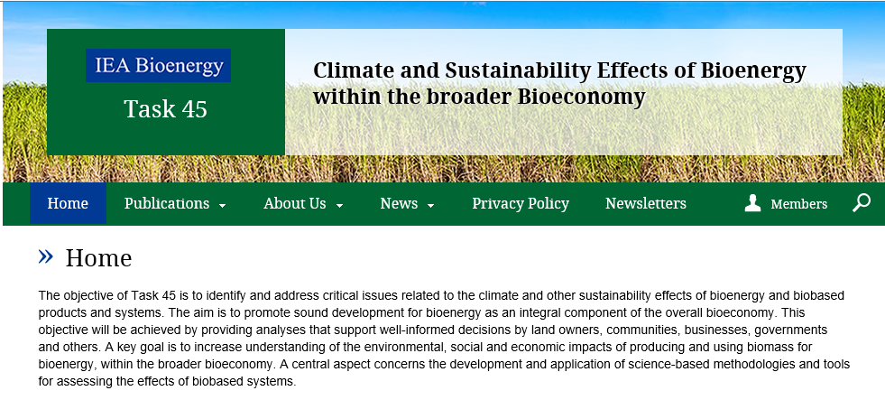

Slide 4
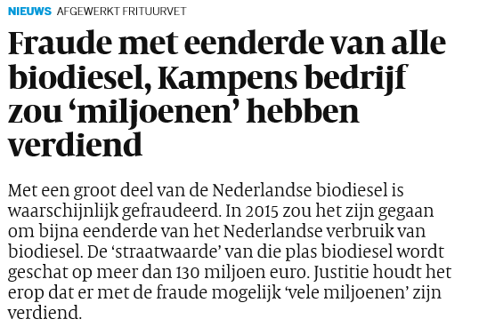

Slide 5
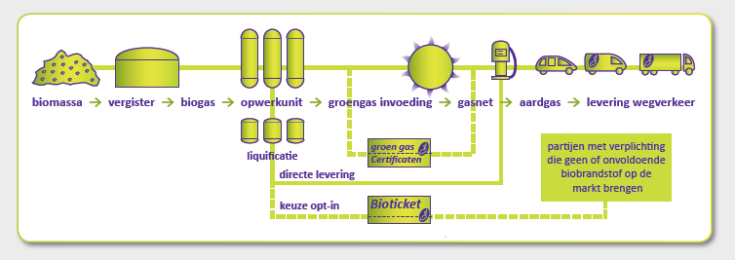
NL certification from Biotickets

Slide 6
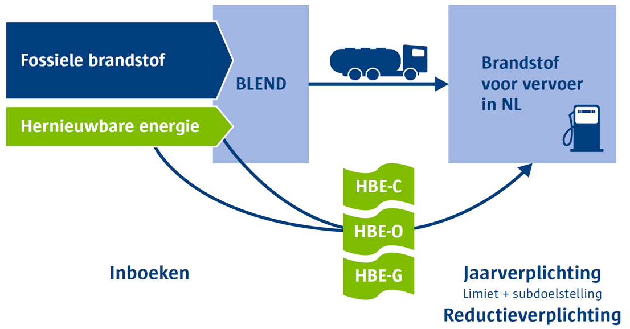
… to Renewable Energy Units (HBE)

Slide 7


