Slide 1
FAPESP
Fundação de Amparo à Pesquisa do Estado de São Paulo
Mission: support research in all fields
Funded by the State of SP: 1% of all tax revenues
All proposals are peer reviewed (26,000 in 2018) Time for decision ~ 70 days; 41% success rate
Annual budget: R$ 1,216 billion in 2018
Fellowships In Brazil: 2,500 SI, 1,150 MSc, 2,400 DrSc, 1,700 Post-docs
Abroad: 1,200 per year
Academic R&D
17 Centers (11-yrs dur.), 400 Thematic (5-yrs), 300 Young Investigators (5-yrs), 2,800 Regular (2-yrs)
University-Industry Joint R&D: PITEs and Engineering Centers
Small business R&D (PIPE): 1,500 RISB’s (246 contracts in 2018, many start-ups)

Slide 2
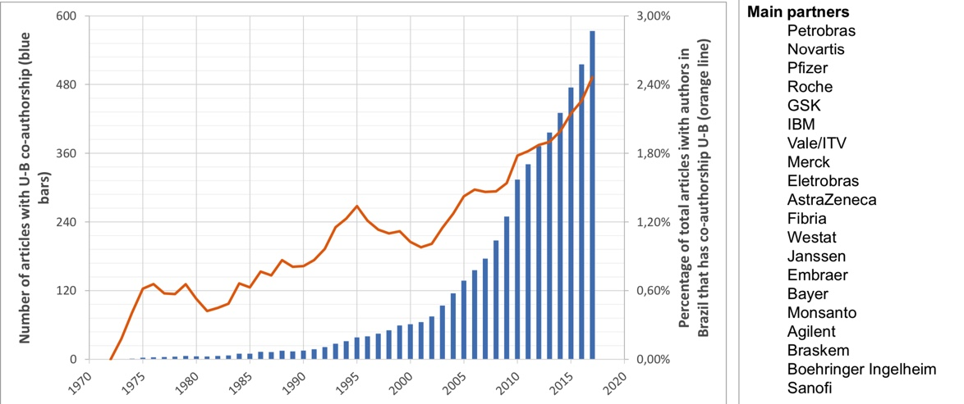
FAPESP
University-Industry Collaborations

Slide 3
http://bioenfapesp.org.br
Fundamental knowledge and new technologies
for a bio-based society:
US$ 200 million
231
560
Research projects
Scholarships
(Brazil and abroad)
1100+
400+
Scientific publications
169
Researchers involved
Start-ups

Slide 4
Genome sequence
Molecular markers
Disease-free seeds
Drought tolerance
Sugarcane transgenics
Digital agriculture
Artificial intelligence
Fermentation automation
New solvents
Anhydrous ethanol
Molecular sieves
Energetic and economic gains
Bio-oils from different feedstocks
Biobutanol
Building-blocks
New uses for lignin
ETBE, green PET
Nanocellulose
Ethanol fuel cells
Lower N2O emissions
New uses for vinasse
Accelerate the transition for a low carbon economy
Global expansion of bioenergy
BIOMASS
Contribute with knowledge and technologies for Sugarcane Improvement
Enable a Systems Biology approach for Biofuel Crops
BIOFUEL TECHNOLOGIES
Increasing productivity (amount of ethanol by ton of sugarcane), energy saving, water saving and minimizing environmental impacts
BIOREFINERIES
Complete substitution of fossil fuel derived compounds
Sugarchemistry for intermediate chemical production and alcoholchemistry as a petrochemistry substitute
ENGINES
Flex-fuel engines with increased performance, durability and decreased consumption, pollutant emissions
Aviation applications
SUSTAINABILITY AND IMPACTS
Studies to consolidate sugarcane ethanol as the leading technology path to ethanol and derivatives production
Horizontal themes: Social and Economic Impacts, Environmental studies and Land Use

Slide 5

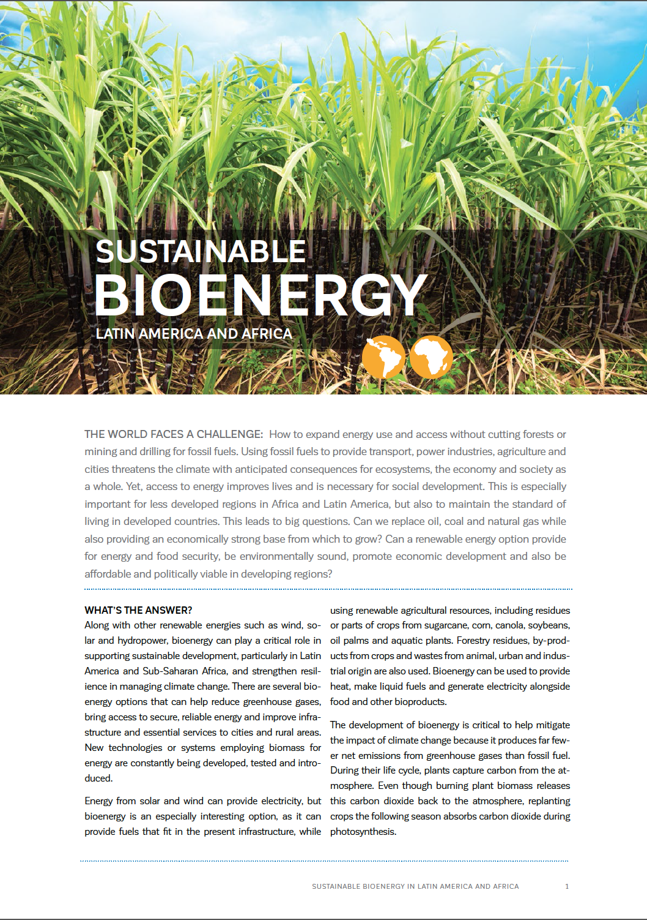
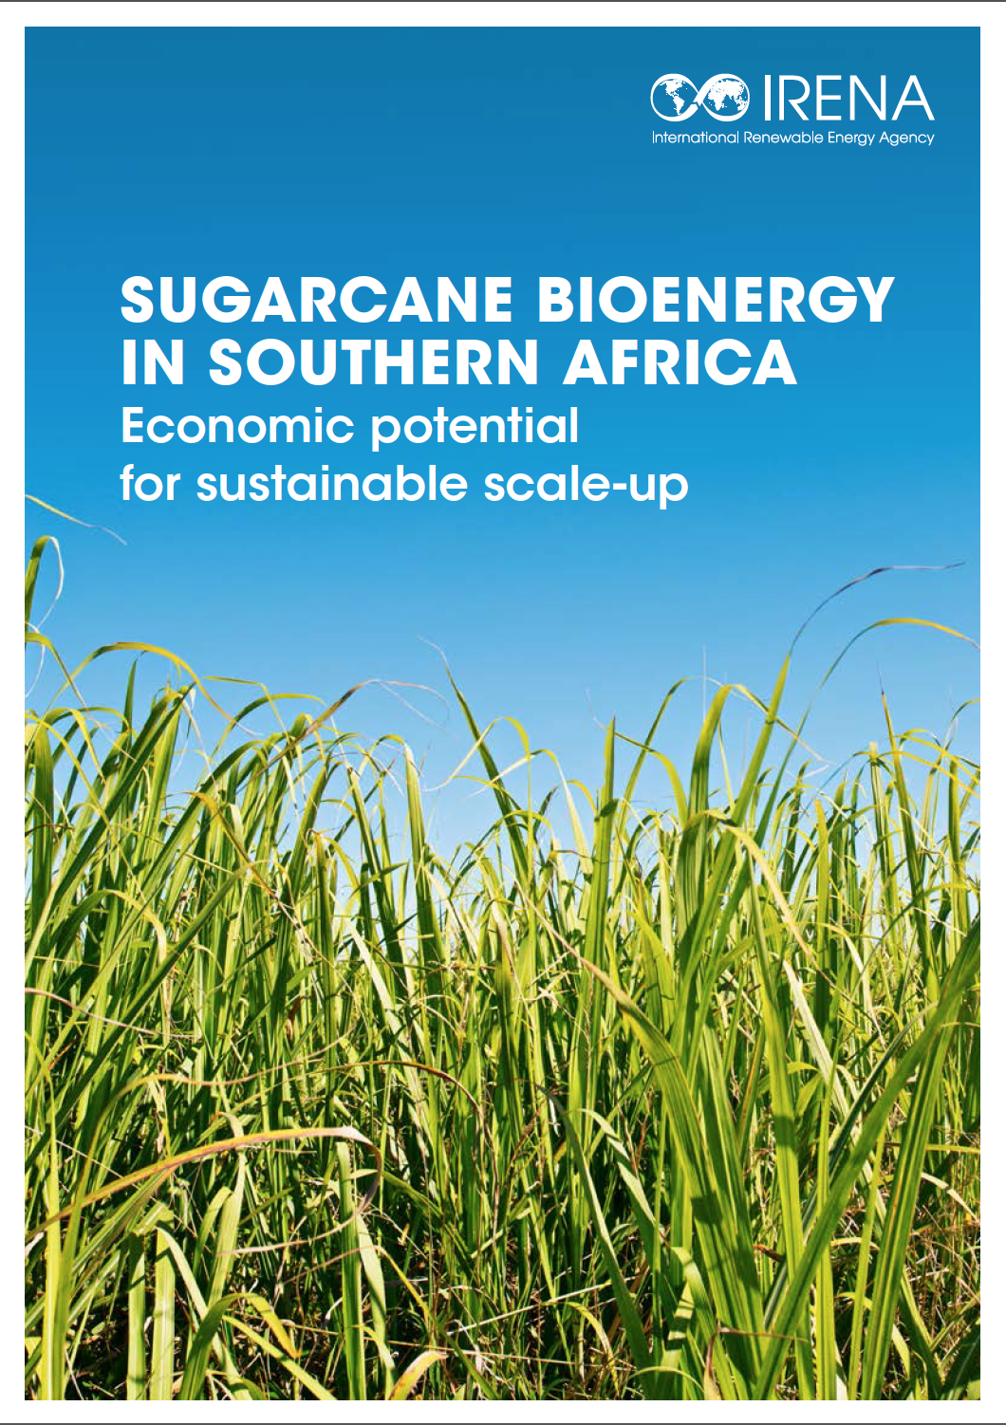
http://bioenfapesp.org/scopebioenergy
SCOPE Bioenergy & Sustainability
A global assessment of Bioenergy & Sustainability
154 experts from 31 countries
Scientific assessments
English printed (hard copy): ISSN 2411-6149
English online: ISSN 2412-0286
Portuguese online: ISSN 2413-4473

Slide 6
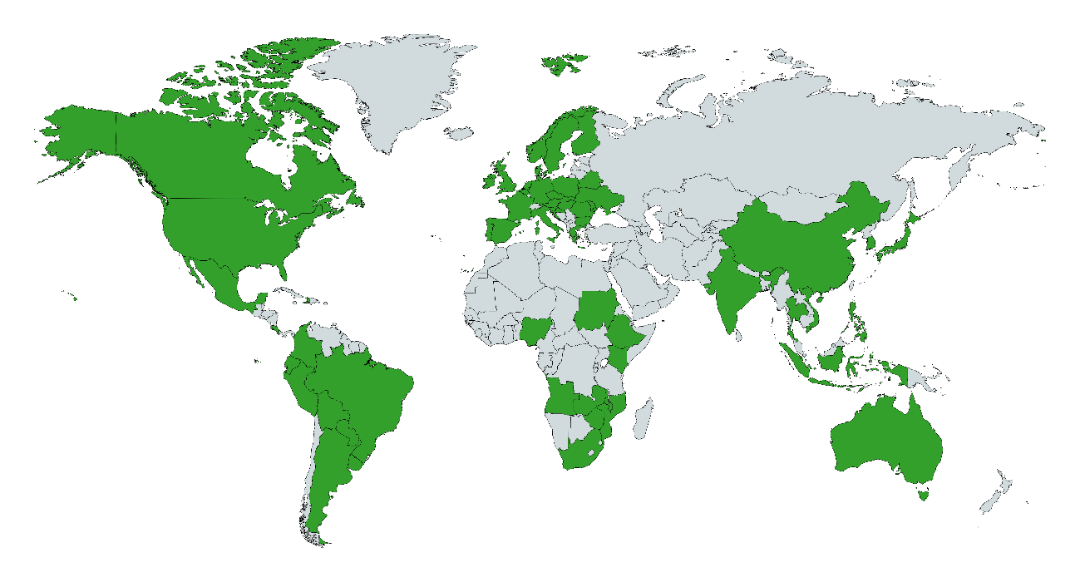
Countries adopting biofuel blends
Nogueira and Skeer (2019). Sugarcane bioenergy in Southern Africa. Economic potential for sustainable scale up. IRENA.

Slide 7
335 million tons
CO2eq avoided emissions with E20
Country | Sugarcane production in 2015 (10e3ton) | Sugarcane potential production on 1% of the current pasture land (10e3ton)
Argentina | 22,54 | 86,8
Bolivia | 7,192 | 26,4
Colombia | 36,71 | 31,36
Costa Rica | 4,266 | 1,04
Cuba | 19,3 | 2,24
Dominican Republic | 4,535 | 960
Ecuador | 10,106 | 4
El Salvador | 6,578 | 480
Guatemala | 23,653 | 1,6
Honduras | 5,171 | 1,44
Mexico | 1,475 | 160
Nicaragua | 55,396 | 64,72
Panama | 2,381 | 2,64
Paraguay | 6,701 | 1,2
Peru | 4,186 | 13,6
Venezuela | 5,569 | 15,04
Angola | 552 | 45,696
Malawi | 2,894 | 1,568
Mauritius | 4,009 | 8
Mozambique | 3,084 | 37,232
South Africa | 14,861 | 71,016
Swaziland | 5,517 | 872
Tanzania | 2,717 | 24
Zambia | 4,145 | 16,92
Zimbabwe | 3,348 | 10,24
Total production (ton/year) | 808,334,000 | 2,938,752,000
ton CO2eq (0.114 t CO2eq/ton) | 92,150,076 | 335,017,728

Slide 8
Task 39 Emerging Markets Analysis
1) Biofuels Production and Consumption: Status, Advances and Challenges;
(2) Biofuels policies used to help encourage the production and use of biofuels;
(3) Advances in biofuels technologies taking into account TEA and LCA;
(4) A list of main/keyplayers in science and technology for each region/country;
(5) Elaboration of offer curves and gaps.

Slide 9
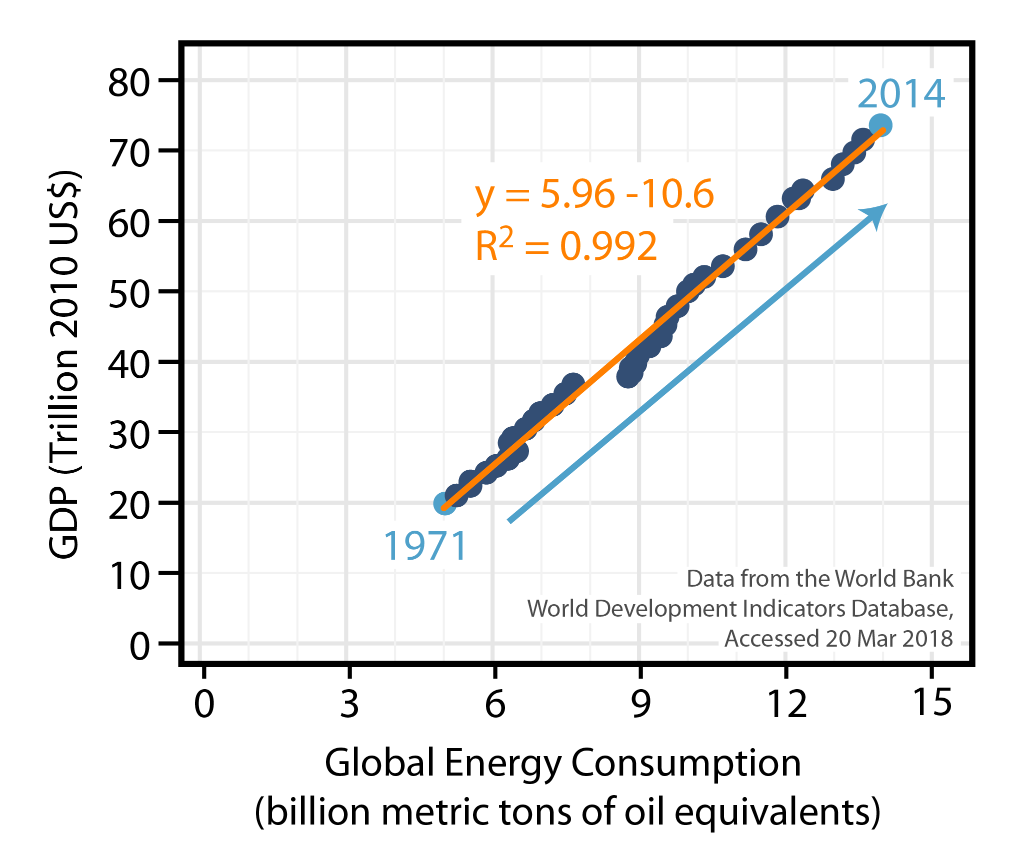
Motivation
Energy Consumption and Wealth : A Linear Relationship
Dale – B- Scope 2015-http://bioenfapesp.org/scopebioenergy/index.php

Slide 10
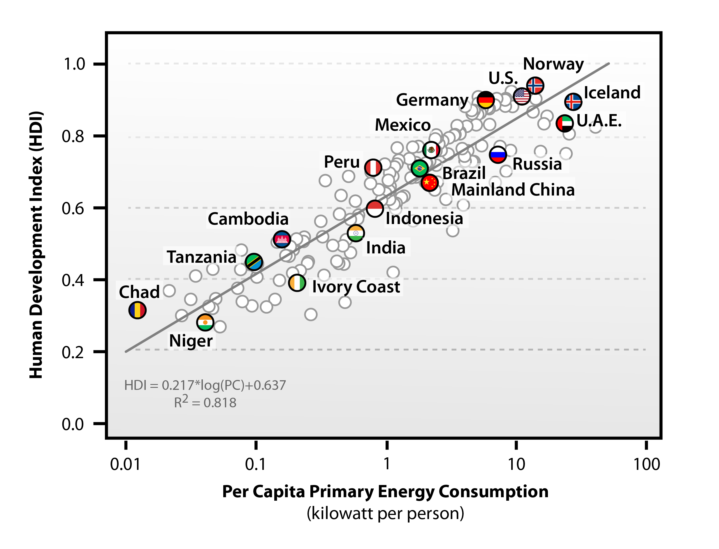
Energy Consumption & Human Well Being are Linked:
NO Countries have Both High HDI and Low Energy Use
Most of “in development countries” will need increase drastically energy availability
By Bruce Dale–Michigan State University/Unicamp
No enough energy (including fuels )for everybody, even with nowadays population
Biobased processes should be energetically efficient and, if possible, to export energy
Relationship between 2008 per capita primary energy consumption and human development indices (HDI) for 171 countries. Human development indices are also from the HDRO: http://hdr.undp.org/en/statistics/hdi/ . Per capita primary energy consumption data are from the U.S. Energy Information Administration (EIA): http://www.eia.gov/cfapps/ipdbproject/IEDIndex3.cfm .
All data were accessed on Nov. 17, 2011.

Slide 11
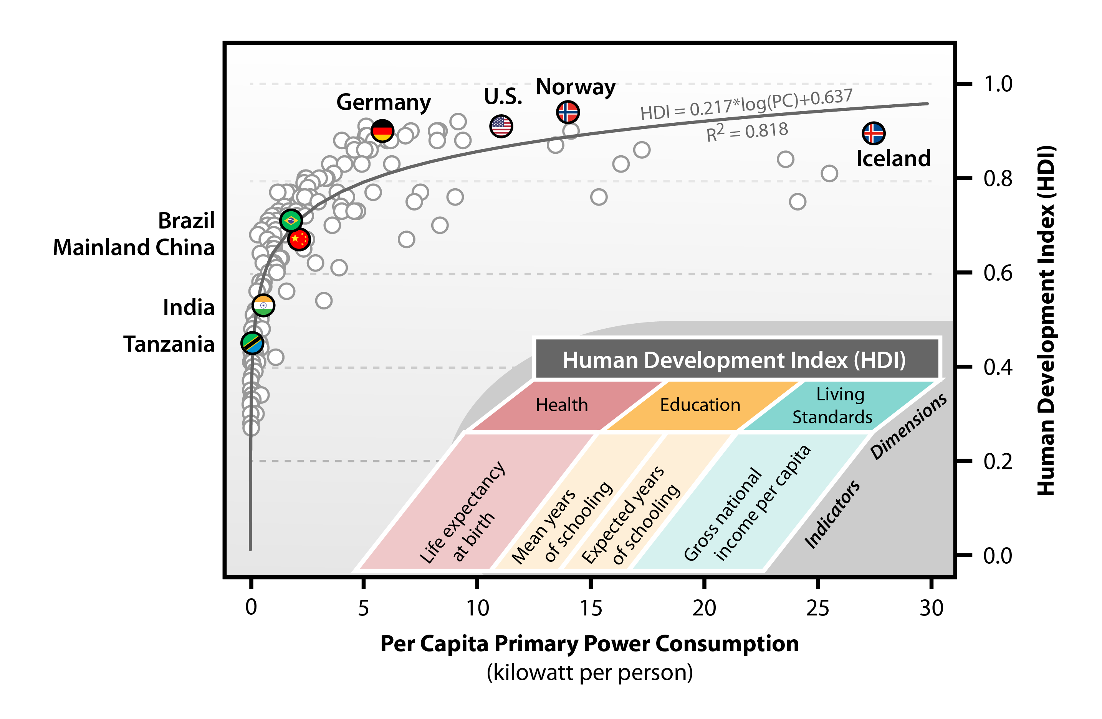
Energy Consumption & Human Well Being are Linked
By Bruce Dale–Michigan State University/Maciel Filho Unicamp
Relationship between 2008 per capita primary energy consumption and human development indices (HDI) for 170 countries. Qatar is not shown with a per capita primary energy consumption of greater than 30 kilowatts per person. Based on a figure by Martinez and Ebenhack, 2008; and the inset is based on a figure from the Human Development Report Office (HDRO) of the United Nations (UN): http://hdr.undp.org/en/statistics/hdi/ . Human development indices are also from the HDRO: http://hdr.undp.org/en/statistics/hdi/ . Per capita primary energy consumption data are from the U.S. Energy Information Administration (EIA): http://www.eia.gov/cfapps/ipdbproject/IEDIndex3.cfm .
All data were accessed on Nov. 17, 2011.

Slide 12
METHODOLOGY
2
Data Collection from Offical Sources of each Country
Biofuels Production and Consumption
Biofuels policies used to help encourage the production and use of biofuels
A list of main/keyplayers in science and technology for each region/country
Elaboration of offer curves and gaps (year by year and evolution)
Identification of the Advances in biofuels technologies taking into account TEA and LCA;
Status of development
Number and Scale of Plants in Production
Process in Development
Scientific Procedure
Biomass Agricultural Ratio for each country and Biofuel
Process Simulation
Use of Exerxy concepts

Slide 13
Techno-Economic Analysis and Life-Cycle approach
Inputs
Outputs
Techno-economic analysis (TEA) and Life-cycle assessment (LCA)
Fuel selling price
Feedstocks and conversion process data
Carbon Efficiency
Capital Costs
Purchase cost
Installation cost
Engineering and construction costs
Financing
Operating Costs
Raw materials
Energy
Labor
Waste treatment
Emission Inventory
Upstream
Logistics
Conversion process
TEA – internal Rate of Return, Pay Back Time, Minimum Selling Price, Technology Stage Development

Slide 14
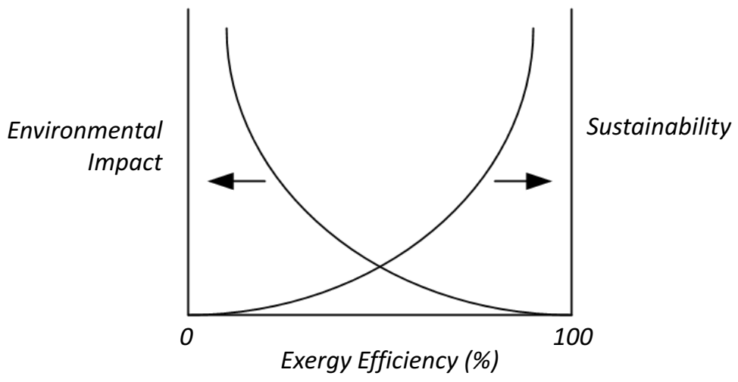
EXERGY ANALYSIS
Exergy is defined as he maximum work that can be obtained by means of reversible processes from a thermodynamic system that interacts with the components of the environment until the dead equilibrium is attained (Szargut et. al. 1988)
As Measure of Sustainability of Energy System
ENERGY
CONVERSION
EFFICIENCY
PRINCIPLE OF CONSERVATION OF ENERGY
EXERGY
COST OF PRODUCTION
RENEWABILITY EXERGY INDEX
ENTROPY
INCREASE IN ENTROPY PRINCIPLE
DINCER and ROSEN. Exergy: Energy, Environment and Sustainable Development. 2ED, 2013.

Slide 15
METHODOLOGY
Raw material processing and electricity generation process with stream and CO₂ emissions:
Exergy
Raw
material
Processed
fuel
Processing
STEP
Fuel
Electricity STEP
Electricity
c_{NR ...n}
Processing
STEP
∑c_{NR}
c_{NR ...n}
Electricity
STEP
∑c_{NR}
c_{T ...n}
∑c_{T}
c_{T ...n}
∑c_{T}
c_{CO2...n}
∑c_{CO2}
c_{CO2...n}
∑c_{CO2}
Processing Step
Electricity Generation Step
When more than one product is produced in a step, data from exergoeconomy analyses of the step is employed to properly split the exergy and CO₂ costs between the processed products in a rational manner.

Slide 16



KEY PERFORMANCE INDICATORS
Exergy efficiency
Irreversibility rate
CO2 equivalent index in exergetic base
Renewability exergy index
0 ≤ λ < 1
environmentally unfavorable
λ > 1
environmentally favorable
λ = 1
reversible process with non-renewable inputs
λ ∞
reversible process with renewable inputs
Oliveira Junior, S. Exergy production, cost and renewability. Springer-Verlag London, 2013

Slide 17

Comparative Energy Balance to Crop Choice as Feedstock (e.g. Ethanol)
PROCESS Feedstock | Corn¹ | Switchgrass¹ | Sugar cane²
Energy unit | (GJ/ha.yr) | (GJ/ha.yr) | (GJ/ha.yr)
Crop production energy consumption | 18.9 | 17.8 | 13.9
Biomass Energy | 149.5³ | 220.2 | 297.1⁴
Agricultural energy ratio | 7.9 | 12.3 | 21.3
Ethanol production energy consumption | 47.9 | 10.2 | 3.4
1- Source: ORNL, 2- Source: Copersucar/UNICAMP, 3-No credit for corn stover, 4- No credit for sugar cane leaves,
Ethanol Productivity
Brazilian sugarcane ethanol is the biofuel presenting the highest productivity in the world (today: 7,600 l/ha.year) and the best renewable energy ratio:
9-13 liters renewable energy/liter fossil energy
US corn ethanol: 1.4-1.8
German biodiesel: 3.0
Oil - Each unit of energy invested to produce oil in the 1940s yielded the equivalent of 110 energy
units (1 to 100) . Nowadays – depending upon the oil field 1-10
Maciel Filho , 2014

Slide 18












Countries classification
Latin America
 |  | Brazil
 |  | Argentine
 |  | Colombia
 |  | Mexico
Africa
 |  | South Africa
 |  | Nigeria
Asia
 |  | India
 |  | China
Europe
 |  | Russia

Slide 19
CONTENT
Total energy production (Mtoe)
Total energy consumption (Mtoe)
Crude oil production (Mt)
Crude oil input to refineries (Mt)
Refined oil products production (Mt)
Natural gas production (bcm)
Natural gas domestic consumption (bcm)
Electricity production (TWh)
Electricity domestic consumption (TWh)
Share of renewables in electricity production (%)
CO₂ emissions from fuel combustion (MtCO₂)

Slide 20

Total energy production (Mtoe)

Slide 21
Total energy consumption (Mtoe)

Slide 22
Crude oil production (Mt)

Slide 23
Natural gas production (bcm)

Slide 24
Natural gas domestic consumption (bcm)

Slide 25
Electricity production (TWh)

Slide 26
Electricity domestic consumption (TWh)

Slide 27
Share of renewables in electricity production (%)

Slide 28
CO₂ emissions from fuel combustion (MtCO₂)

Slide 29
Matrix of Fuels per country

Slide 30
BRAZIL
Final energy consumption (2017)
Gasoline contais 27% of ethanol
BRAZILIAN ENERGY BALANCE, BEN 2018
Ministry of Mines and Energy – MME
http://epe.gov.br/pt/publicacoes-dados-abertos/publicacoes/balanco-energetico-nacional-ben
Notes:
Tonelada equivalente de petróleo (tep)
mil tep (2018)

Slide 31
Ethanol and gasoline in Brazil
Oscillation - harvesting period
Corn ethanol is coming with
two harvesting by year
Ethanol: hydrous+anhydrous ethanol (average: 70%+30%)
Gasoline: type A – at refinery gate, before bleding with ethanol for mandatory E27 blend
Source: ANP – National Agency of Petroleum, Natural Gas and Biofuels (Brazil), available in http://www.anp.gov.br/dados-estatisticos, accessed in September 11th 2019.

Slide 32
Biodiesel and diesel in BRazil
Biodiesel: pure, before blending (B100).
Diesel: S10 + S500 (sulfur content in ppm) – proportion in sales: 31% S-10, 69% S-500.
Source: ANP – National Agency of Petroleum, Natural Gas and Biofuels (Brazil), available in http://www.anp.gov.br/dados-estatisticos, accessed in September 11th 2019.

Slide 33
ARGENTINE
ARGENTINE ENERGY BALANCE, 2017
Ministry of Energy
https://www.argentina.gob.ar/energia/hidrocarburos/balances-energeticos
Notes:
Ministerio de Energia - Argentina
BALANCE ENERGÉTICO NACIONAL 2017

Slide 34
COLOMBIA
Colombian Energy Balance, 2017
UPME
http://www1.upme.gov.co/InformacionCifras/Paginas/BECOENERGTICO.aspx
Notes:
UPME - PRODUCCIÓN DE COMBUSTIBLES

Slide 35
MÉXICO
Mexican Energy Balance, 2017
SIE - Sistema de Información Energética
http://sie.energia.gob.mx/

Slide 36
SOUTH AFRICA
South Africa-RSA_2016-Commodity-Flow-and-Energy-Balance
Department of Energy
http://www.energy.gov.za/files/energyStats_frame.html

Slide 37

NIGERIA
Nigeria - The International Energy Agency
https://www.iea.org/countries/Nigeria/
Notes:
https://www.iea.org/countries/Nigeria/

Slide 38
INDIA
Energy Commodity Balance for the year 2016-17
Ministry of Power - India
https://powermin.nic.in/

Slide 39
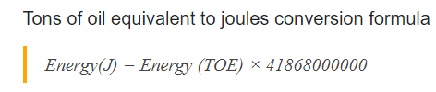
CHINA
China just announced
20% of biodiesel
by 2022?
China Energy Portal
http://www.stats.gov.cn/english/Statisticaldata/AnnualData/

Slide 40
RUSSIA
Final energy production (2016)
Ministry of Energy of the Russian Federation
https://minenergo.gov.ru/en/activity/statistic

Slide 41
Type of Desired Result/Information
Eg. Energy Matriz and Biorefinery in Brazil
Availability , Sustainbility, Easess to transform, but also Suitability for each use
Sugar cane- Ethanol for light cars
Soya Bean/Palm Oil (Reforestation by Vale)/Animal Fat- Biodiesel
Eucalyptus- Biorefinery and Co-Processing (143.21 million cubic meters (71 million dry tons / year)
Biogas (Biomethane)
Jet Fuel – Macauba and FAME – research stage

Slide 42
Immediate Applications (easier to be understood with established market)- Biomass is more consolidated
Biofuels
Bioethanol for light cars
Biobutanol for light cars
Additives for bioethanol use in heavy engines
Biodiesel for heavy engines
Additives for biodiesel – ethyl levulinate
Biokerosene for jet fuels and maritime fuels
H₂ Production from Ethanol (Hydrogenation is critical in many routes)- Fuel Cell by Ethanol
Co-Processing (depending of the product is easier: FCC for several renewable fuels or HDT for diesel)
Biorefineries- Commodities and High Added Value Chemicals
Bioenergy- combined cycles
Biobase materials – including applications for medical and food areas

Slide 43

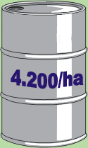
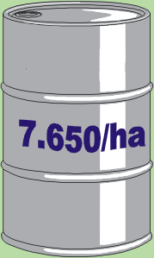
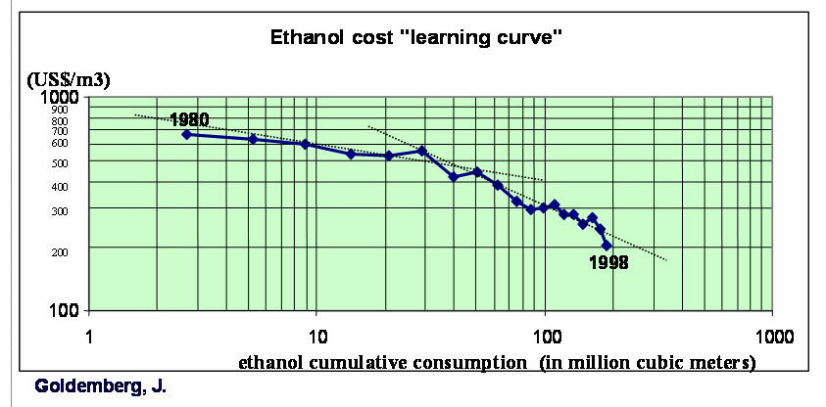
Evolutionary Engineering and the 1G Learning Curve
Learning curve of Biochemical/Thermochemical 2G Routes → important knowledge
1G
(40 years)
2G Biochemical
40 years
In 10 years?
70’s
Today
82 %
40-60 %
12.000/ha
2 Millions ha- Sugar 4.5 Mt,
80 Mt of Sugar Cane- 1 Billion liters
8.5 Millions ha
Sugar 36 Mt
23 Billions liters
.
Today - 3 - 2G Ethanol Plants in Operation
US$ 20-25 cents → production cost of
1 liter of ethanol (70% due to sugar cane)

Slide 44
Ethanol as Fuel and Chemicals in Brazil
Increase in oil price impacting fuel price (earlier 70´s)
1978 Proalcool Program
1978 Fiat 147 powered by Ethanol
Advent of flex fuel vehicles (2003)
Ethanol-chemistry is ready to use- early 80´s, ethylene,acethaldehyde, acetic acid, ethyl acetate, higher alchools etc. plants were built an used
Biomass Production and Ethanol Process Improvement
2G Ethanol (3 plants in operation)
Corn ethanol 1st Plant in Brazil and Energ-Cane
International price of sugar is decreasing systematically
October 2019 – Hybrid Toyota Corolla (Otto cycle Engine and Electrical) with Flex fuel Engine
Fuel Cell Engine with Ethanol 2019 ( Nissam in test phase )
RenoBio- from 2020

Slide 45
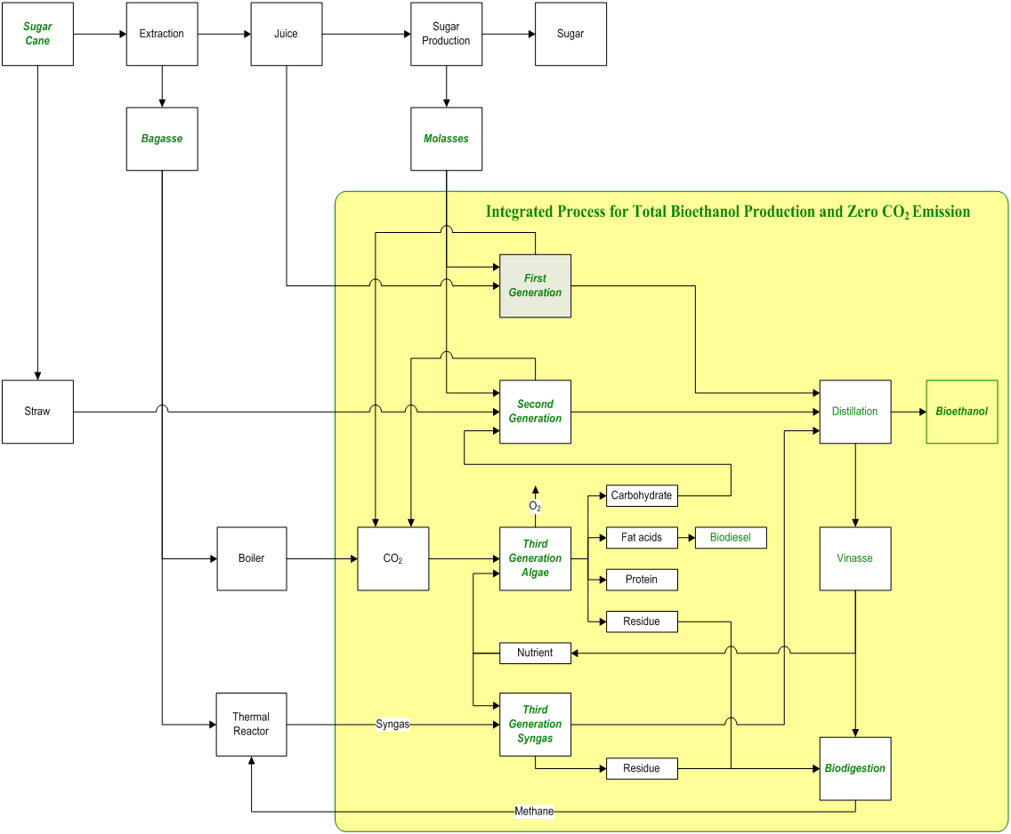
Integrated Circular Process
Zero Generation Process→Chemicals
Zero CO2 emission
LEVULINIC ACID
Purified glycerin for pharmaceutical
.Glycerin as carbon source for
propionic acid and other
high added organic acids
.Ethylene, and Syngas Production
Electricity
CO2+ H₂
for Chemicals
H₂ from water
eletrolysis
Fertilizer
Source: Thematic Project Fapesp– Coordinator Maciel Filho

Slide 46
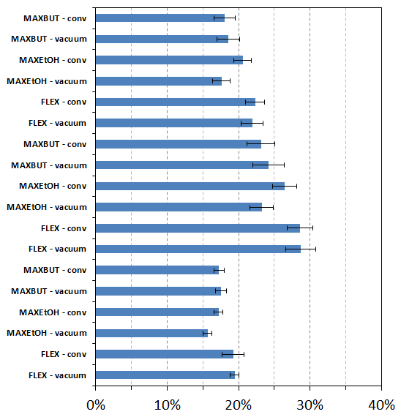
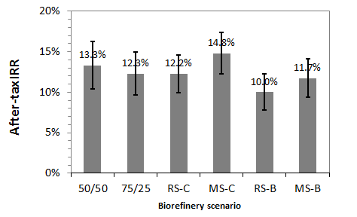
Economic performance- one of the criteria to take decisions
Error bars: std. deviation of 10,000 simulations
Butanol
Dilute acid
Ethanol
Flex
Business
as usual
Butanol
Chemical
Steam
Explosion
Butanol
Biofuel
Flex
Organosolv
Flex
IRR – Internal Rate of Return
Assumpçao et. al, Bioprocess and Biosystems Engineering, May, 2018

Slide 47
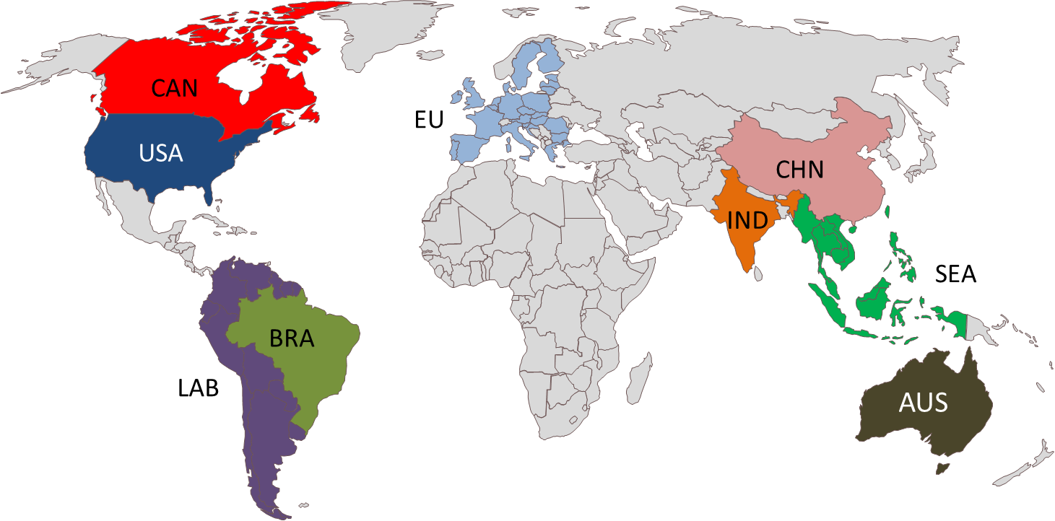
Levulinic acid and ethyl levulinate
Economic feasability of ethyl levulinate production
Depends upon biomass availability (quality and price) and commodity price (diesel) inside a single market
Notes:
Viabilidade econômica do processo depende do preço da biomassa e do tipo de biomassa disponível localmente (complicado transportar), e também depende do preço do commodity que você pretende concorrer, que no caso do levulinato de etila é o diesel.
Use este slide para explicar as regiões do mundo que foram consideradas no estudo.

Slide 48
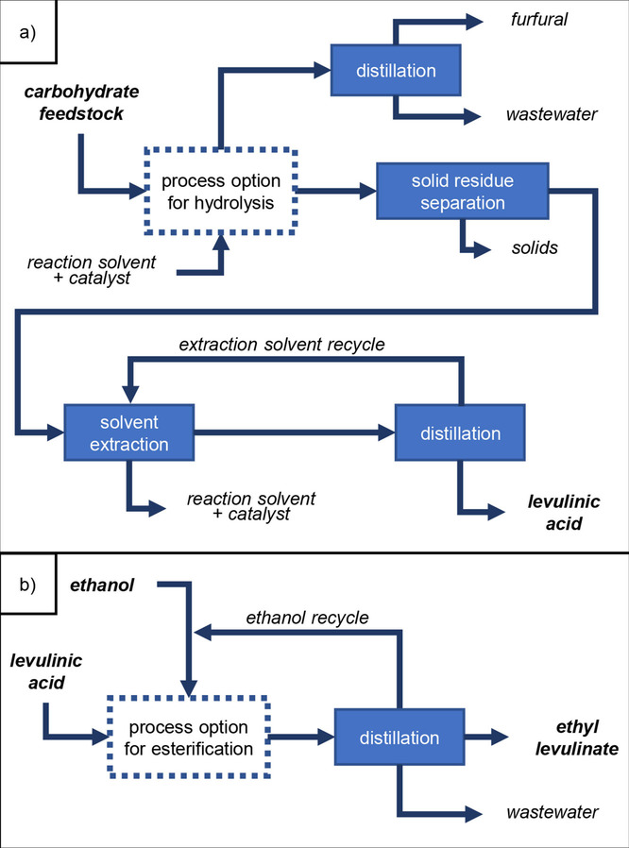
Levulinic acid and ethyl levulinate
Ethyl levulinate
Block flow diagrams of a) the process to obtain levulinic acid and b) its conversion to ethyl levulinate. Blocks with dashed lines are the process steps that change according to each case simulated.
J. F. Leal Silva, R. Grekin, A. P. Mariano, R. Maciel Filho, Making Levulinic Acid and Ethyl Levulinate Economically Viable: A Worldwide Technoeconomic and Environmental Assessment of Possible Routes. Energy Technol. 2018, 6, 613.

Slide 49
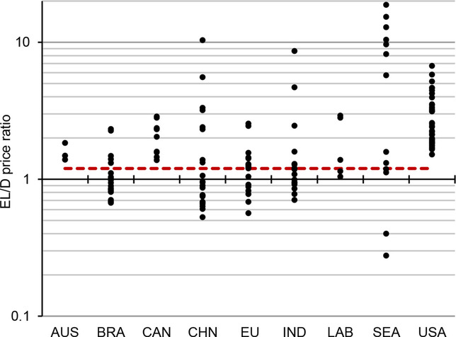
Levulinic acid and ethyl levulinate
Methodology
Minimun selling price of ethyl levulinate to attain an EBITDA margin of 30%.
Price of ethyl levulinate compared to the local diesel price: EL/D price ratio.
Ratio of EL price to local low‐sulfur diesel price on an energy basis. The red dashed line represents an upper limit ratio of 1.2 to cover cases in which a premium of 20 % over the diesel price is offered to encourage the production of ethyl levulinate.
J. F. Leal Silva, R. Grekin, A. P. Mariano, R. Maciel Filho, Making Levulinic Acid and Ethyl Levulinate Economically Viable: A Worldwide Technoeconomic and Environmental Assessment of Possible Routes. Energy Technol. 2018, 6, 613.
Notes:
Methodology: several process options were tested using local biomass as feedstocks.
What is important to highlight: many process options have opportunity to produce ethyl levulinate cheaper than the current price of low sulfur diesel (at refinery gate, not at the pump – this is also important to mention). The comparison of prices is done considering the Lower Heating Value (LHV) of both fuels (diesel and ethyl levulinate).
EBITDA margin methology was used instead of cash flow analysis because the processes are not well developed yet. Therefore, estimations of capital expenditure – a requirement for cash flow analysis - are likely to be very wrong because there is no solid knowledge on the required equipment.
Interesting takings about the graph:
most processes in the US and CAN are not feasible because diesel is cheap in those regions. EU takes advantage on this point.
authors investigated a process for production of levuinic acid using palm residues (which is available in Southeast Asia – SEA) using ionic liquid – disastrous economic result: EL/D ratio above 10.

Slide 50
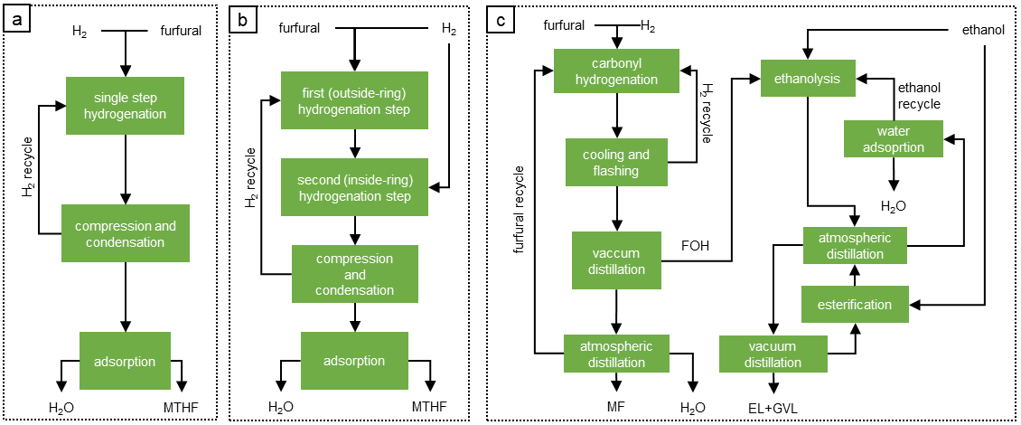
Furfural and mTHF
Furfural to other fuels – BR, CN, EU, and US
Chemical routes to convert furfural to (a) MTHF in a single-step hydrogenation reactor – 1SM; (b) MTHF in a two-step hydrogenation process – 2SM; and (c) ethyl levulinate – 2EL. Chemical routes were simulated in Aspen Plus.
J.F. Leal Silva, A.P. Mariano, R. Maciel Filho, Economic potential of 2-methyltetrahydrofuran (MTHF) and ethyl levulinate (EL) produced from hemicelluloses-derived furfural, Biomass and Bioenergy, 119, 2018, 492-502, https://doi.org/10.1016/j.biombioe.2018.10.008.
Notes:
Routes from furfural to biofuels: furfural to MTHF (can be blended with gasoline) and furfural to a mixture of ethyl levulinate and gamma-valerolactone (GVL) – this can be blended with diesel.

Slide 51
Furfural and mTHF
Furfural to other fuels – BR, CN, EU, and US
IRR of all scenarios considering a furfural price of $216/t. The dashed line shows the minimum acceptable rate of return (MARR) of 10%, and hatched bars indicate scenarios in which the IRR cannot be calculated because of a negative cashflow in any year.
J.F. Leal Silva, A.P. Mariano, R. Maciel Filho, Economic potential of 2-methyltetrahydrofuran (MTHF) and ethyl levulinate (EL) produced from hemicelluloses-derived furfural, Biomass and Bioenergy, 119, 2018, 492-502, https://doi.org/10.1016/j.biombioe.2018.10.008.
Notes:
I considered four differente countries/regions (BR - Brazil, CN - China, EU – European Union, US, United States), three differnet upgrading processes (1SM produces MTHF in a single step hydrogenation, 2SM produces MTHF in a two step hydrogenation process, and 2EL produces ethyl levulinate via a hydrogenation and an ethanolysis), and two different hydrogen sources (SR – steam reforming of natural gas, EW – electrolysis of water using electricity generated from biomass burning, 100% renewable).
Conclusions:
1) low operating costs in China makes it more interesting. Brazil has also potential to upgrade furfural to MTHF
2) 2-step hydrogenation is more economically feasible than the other options (single step hydrogenation of hydrogenation and ethanolysis)
3) Steam reforming is less expensive than electrolysis of water using electricity from biomass → maybe production of hydrogen using solar or wind power might be competitive with steam reforming in the future, but large storage would be required to safely run a continuous hydrogenation process.

Slide 52
Some Observations
. Demand of Energy is expected to increase dramatically in several countries with big population
. Fossil energy is not enough to attend the needs
. Learning curve is important to mature the technology and depends on factors as policy incentives or energy stress in the marked (oil prices or shortage, for instance)
. It is necessary to have clear sustainability index in all process steps
. Some solutions are attractive for some regions/countries and a search for new strategies is necessary for sustainable renewable fuels

Slide 53
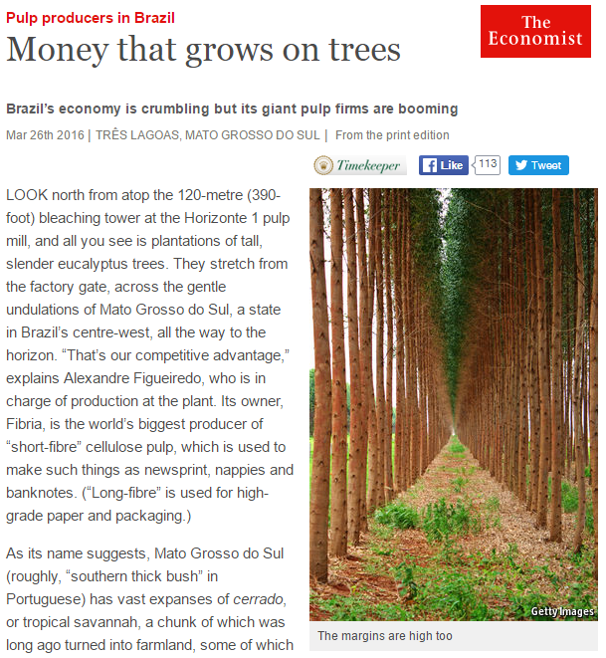
Eucalyptus- Brazilian Production - 143.21 million cubic meters (71 million dry tons / year)
2nd Source of Lignocellulosic feedstock in Brazil (not accounting agricultural waste)
The average productivity of Brazilian eucalyptus plantations reaches 39
m³ / ha year (19.5 dry tonnes / ha year) Source-IBA-2015

Slide 54
Crude oil input to refineries (Mt)

Slide 55
Refined oil products production (Mt)

