Slide 1

BBEST 2020
Brazilian Bioenergy Science and Technology Conferece i
March 30th - April 1st
Hotel Renaissance, São Paulo

Slide 2
Plenary Keynote Panel 1: The place of the low carbon bioeconomy in the new dynamics of global energy
Plenary Panel 2: Bioenergy Status Update and Sustainability Governance
Plenary Panel 3: Demand pull, public policies and recognition of environmental services (mandates, carbon pricing, RenovaBio, Clean Fuels Standard, RED II, LCFS)
Plenary Panel 4: Bioenergy in transportation and the electrification debate
Plenary Panel 5: Financing the Bioeconomy, the role of green bonds and financial institutions
Plenary Panel 6: Technology push policies and supporting the Bioeconomy innovation
Plenary Panel 7: Biofuture Summit Wrap-Up and Open Debate: - Towards a Biofuture Blueprint for the Bioeconomy
Policy Day March 30th, 2020
Bioenergy Innovation

Slide 3
Round Table 1: Aviation Biofuels Takeoff
Round Table 2: The Biobased Future and Biorefining
Round Table 3: Investing in the Biobased Future in Brazil
Round Table 4 - Industrial Implementation of Energy Cane
Parallel Sessions and Round-Tables March 31st and April 1st

Slide 4
http://bbest.org.br
Registration for speakers (with abstracts): November 1st, 2019
Registration discount of 40% for IEA participants (NEED A LIST)
US$ 420

Slide 5
PS 1 - SynBio
PS 2 - Crop Biotech
PS 3 - BIOEN Engines
PS 4 - RISB Biofuel products
PS 5 - Biodiversity Nexus
PS 6 - RISB Biotech
PS 7 - RISB Agronomy
PS 8 - RISB Sustainability
PS 9 - RISB Engines & Aviation
PS 10 - Deconstructing Biomass
PS 11 - BIOEN Biomass
PS 12 - BIOEN Biofuels
PS 13: Bioproducts from Biomass
PS 14 - Innovation Offices
PS 15 - LCA Task 39
PS 16 - Emerging Markets and New Frontiers
PS 17 - BIOEN Biorefinery
PS 18 - IEA Task 39
PS 19 - BIOEN Sustainability
PS 20 - LU for Biomass Production
PS 21 - Integration Food Feed Energy
PS 22 - Wood and Solid Biofuels
PS 23 - IEA Task 45
PS 24 - Biogas
PS 25 - Climate Effects
PS 26 - Horizon 2020, BECOOL, BioValue
Policy Day Plenary March 30th
Parallel Sessions and Round-Tables March 31st and April 1st
Task 39 LCA April 1st 9:00-10:30
Task 39 11:30 – 13:00
Task 45 14:30 – 16:00
Private meetings: April 2-3rd
ExCo
Task39
Task45
1 big room (60 people) + 3 small rooms (U-format, 20 people)
Coffee, lunch included

Slide 6
https://bbest.org.br/scientific-program/bbest-tours
April 6th, 2020
The Iracema Mill
170 km from São Paulo (2 h)
Located in the city of Iracemápolis, in the region of Limeira/SP.
Crushing capacity of 3 million metric tons per harvest season.
Organic fertilizer factory.
Vinasse concentration unit.
Vinasse Biodigestion unit for biogas production.
Special sugar food grade production
Potable ethanol production
Lowest water input mill in the country.
The São Martinho Mill
400 km from São Paulo (3.5 h)
Located in the city of Pradópolis, in the region of Ribeirão Preto/SP.
The world's largest sugarcane processing unit, with a crushing capacity of 10 million metric tons per harvest season.
High capacity of storage and logistics terminal are the strategic differentials.
A thermoelectric unit with capacity of exporting to the grid 300 thousand MW/h.
Database of cane quality.
Proprietary 4G internet connectivity throughout the 135,000 hectars of sugarcane fields.
99.8% of total crop area with mechanized harvesting operation.
Contribution to reforestation efforts: more than 4,2 million tree seedlings planted (Viva a Natureza Project)

Slide 7
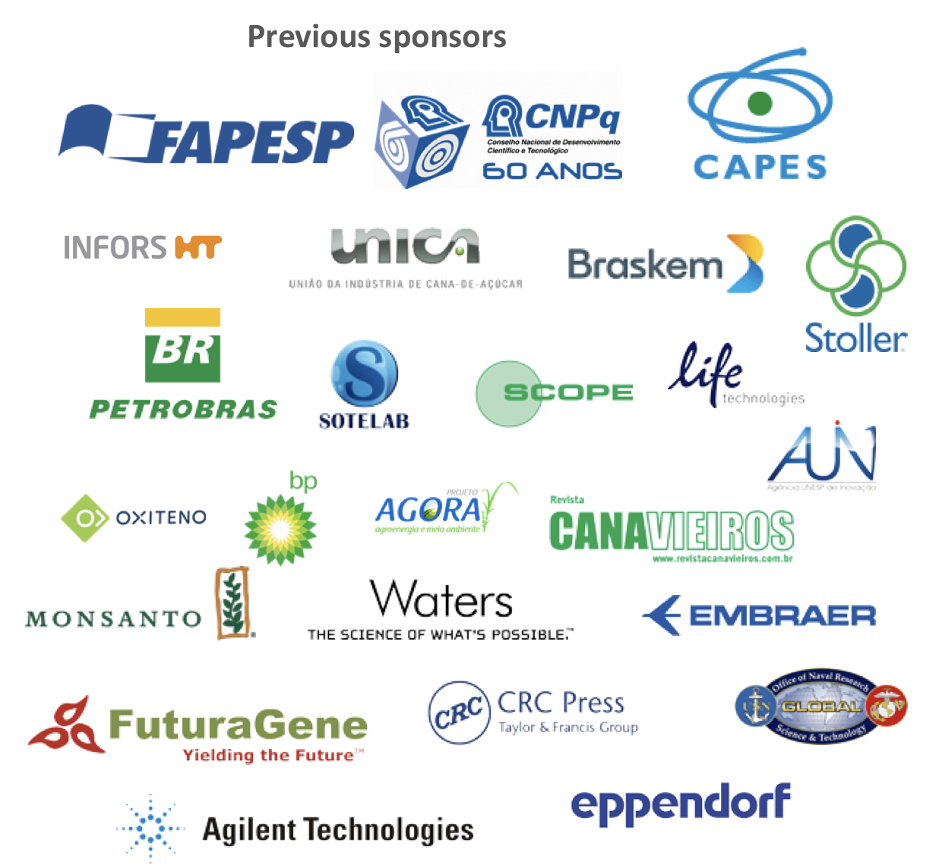
BBEST is a reference conference in bioenergy that combines top scientists, policy makers and representatives of industrial sectors.
Around 400 participants, among researchers, commercial and industrial representatives from 14 countries joined the previous event in 2017 which included the presentation of more than 230 cutting-edge scientific research projects.

